Slide 1
Intro to FHIR and Terminology Services
October 17, 2018
Lloyd McKenzie
SNOMED Day of the Dev

Slide 2

Who am I?
Name: Lloyd McKenzie
Company: Gevity
Background:
One of FHIR’s 3 initial editors
Co-chair FMG, FHIR-I and MnM
HL7 Fellow
Heavily involved in HL7 and healthcare exchange for last 18 years (v2, v3, CDA, etc.)
lmckenzie@gevityinc.com

Slide 3

This presentation
Is licensed for use under the Creative Commons, specifically:
Creative Commons Attribution 3.0 Unported License
(Do with it as you wish, so long as you give credit)
http://bit.ly/dayofthedev2018

Slide 4
Acknowledgements
Grahame Grieve
Lloyd McKenzie
Rob Hausam
Ewout Kramer
David Hay
Brett Marquard
Rik Smithies
et al

Slide 5
Why FHIR?

Slide 6
Complexity Model
Snomed
HL7 V3
openEHR
WS
CDA
Difficulty (log)
XML
How?
HL7 v2
HTTP / HTML
???
Text
Semantic Depth

Slide 7
The Goals of FHIR
Implementer Focus
Target the 80% (common stuff)
Use today’s web technologies
Support human readability
Paradigm & architecturally agnostic
Free

Slide 8
Example – ISO AD type
isNotOrdered, updateMode, flavorId, nullFlavor, controlAct root & extension, validTime low and high, useable period (GTS – no room on the slide), use
home, primary home, vacation home, workplace, direct, public, bad, physical, postal, temporary, alphabetic, ideographic, syllabic, search, soundex, phonetic
0..* parts, each with:
value, code, code system, code system name, code system version, language, type:
address line, additional locator, unit identifier, unit designator, delivery address line, delivery installation type, delivery installation area, delivery installation qualifier, delivery mode, delivery mode identifier, street address line, building number, building number numeric, building number suffix, street name, street name base, street type, direction, intersection, care of, census tract, country, county or parish, municipality, delimiter, post box, precinct, state or province, postal code, delivery point identifier
Notes:
How many of your systems have user interfaces that support even ¼ of this?

Slide 9
Example – FHIR Address
isNotOrdered, updateMode, flavorId, nullFlavor, controlAct root & extension, validTime low and high, useable period (low, high) (GTS – no room on the slide), use
home, primary home, vacation home, workplace, direct, public, bad, physicalvisit, postal, temporary, alphabetic, ideographic, syllabic, search, soundex, phonetic, old
0..* parts, each with:text
value, code, code system, code system name, code system version, language, type:
address line, additional locator, unit identifier, unit designator, delivery address line, delivery installation type, delivery installation area, delivery installation qualifier, delivery mode, delivery mode identifier, street address line, building number, building number numeric, building number suffix, street name, street name base, street type, direction, intersection, care of, census tract, country, county or parish, municipalitycity, delimiter, post box, precinct, state or province, postalCode, delivery point identifier
Notes:
This is what happens when you apply the 80% . . .

Slide 10
FHIR Resources

Slide 11
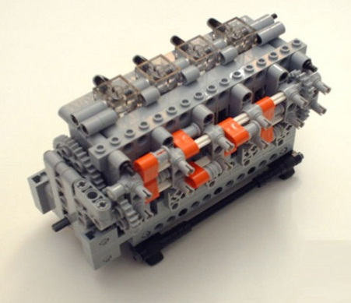
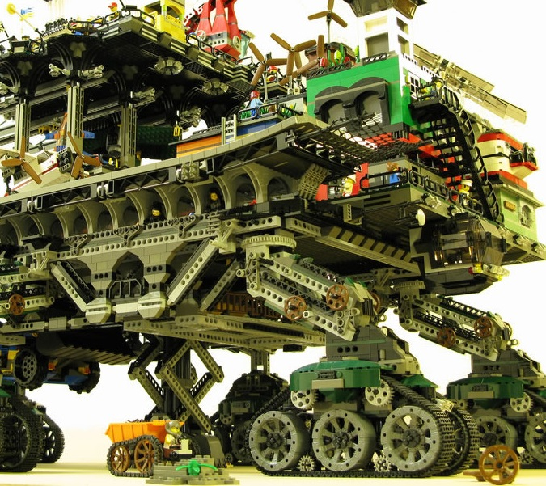

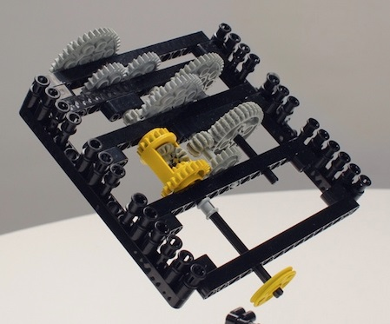
FHIR solutions
Resources
Extensions
Solution
+
=
Notes:
Resources are building blocks, but useful in their own right
Extensions supplement what resource doesn’t cover
Solutions can be simple or complex

Slide 12


Resources
“Resources” are:
Small logically discrete units of exchange
Defined behavior and meaning
Known identity / location
Smallest unit of transaction
“of interest” to healthcare
V2: Sort of like Segments
V3: Sort of like CMETs

Slide 13
What’s a Resource?
Examples
Non-examples
Administrative
Patient, Practitioner, Organization, Location, Coverage, Invoice
Clinical Concepts
Allergy, Condition, Family History, Care Plan
Infrastructure
Document, Message, Profile, Conformance
Gender
Too small
Electronic Health Record
Too big
Blood Pressure
Too specific
Intervention
Too broad
100-150 total - ever
Notes:
And few systems will ever see more than 40-50

Slide 14
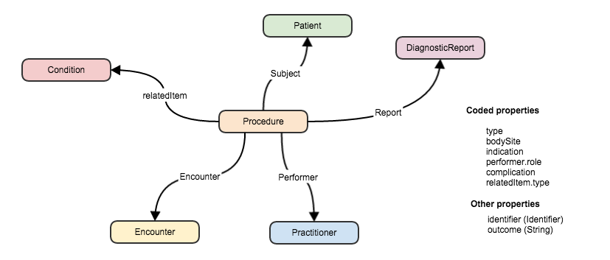
Connecting Resources
FHIR resource
“container” of information that represent something in the real world
Link between resources
Notes:
Can create a ‘network’ of interrelated resources through referencing rather than sending all the data. By resources referencing each other extensively they form a web of information.

Slide 15
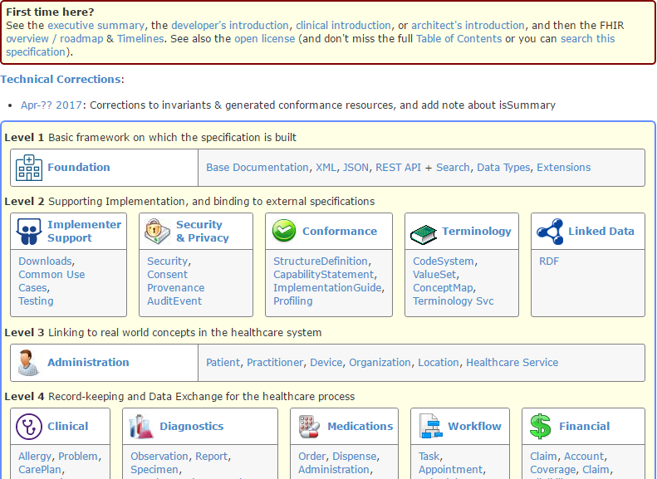
(FHIR home)
hl7.org/fhir
Notes:
Published as HTML
Published using validation process that performs consistency checks – like a software build
Really shouldn’t require much guidance to read, but a few things to call out
Objective of spec is developer can skim and decide in < day

Slide 16



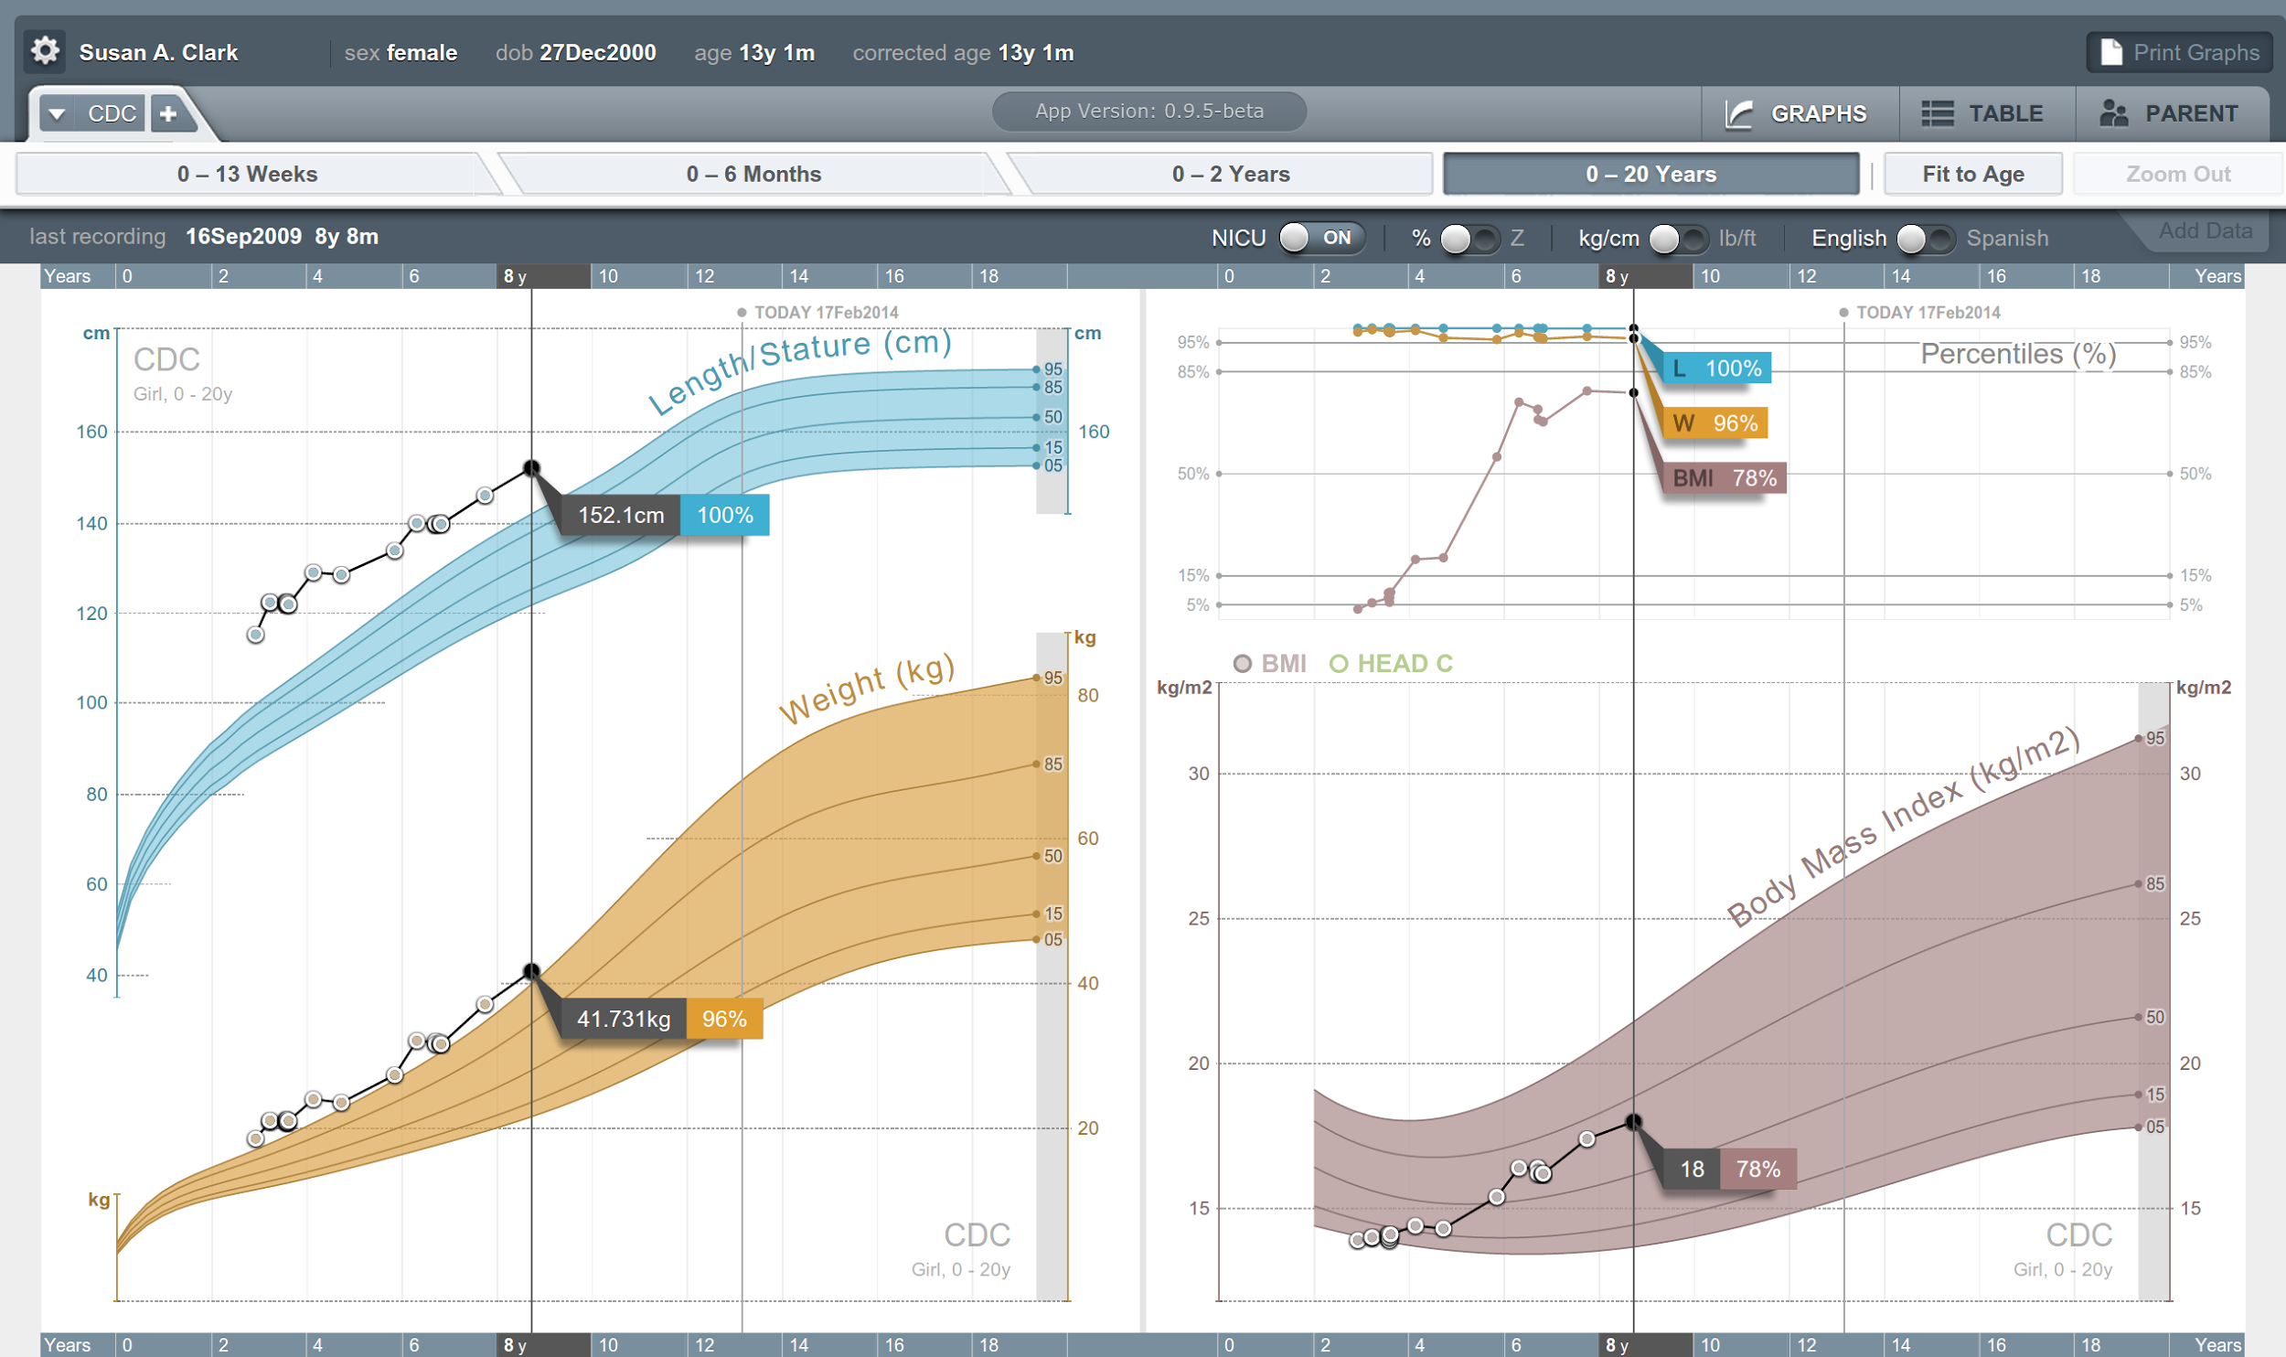


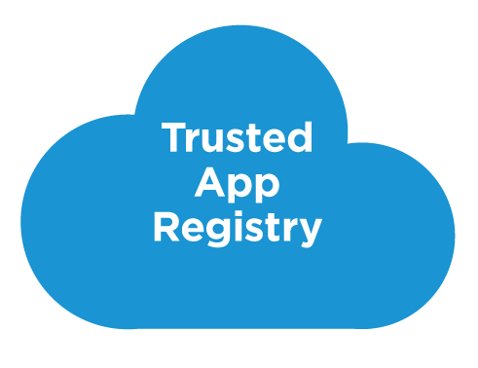



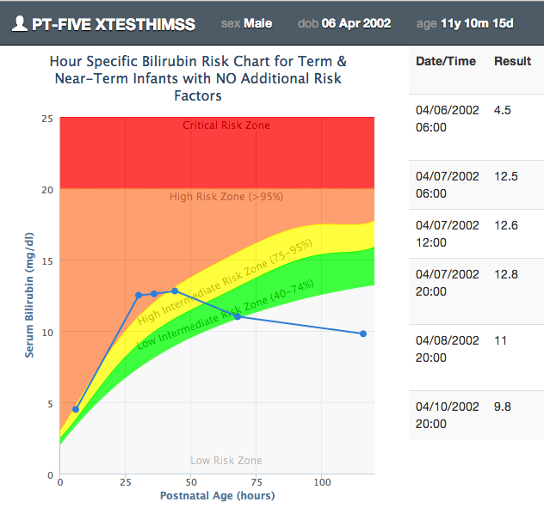







SMART on FHIR
Mobile Apps
Web Apps
OAuth2
REST API
MU-oriented FHIR Data Profiles
Underlying Health IT Systems
Your system here.

Slide 17
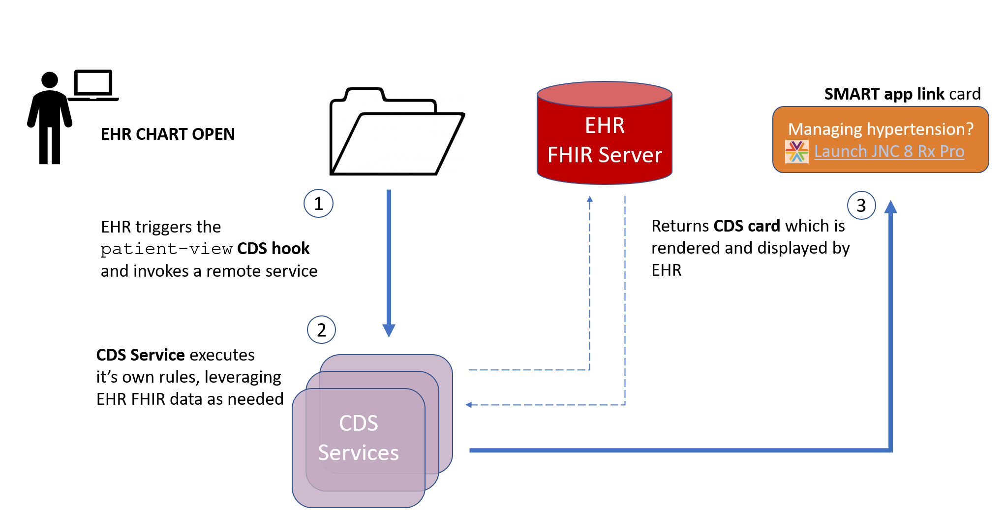
CDS Hooks

Slide 18
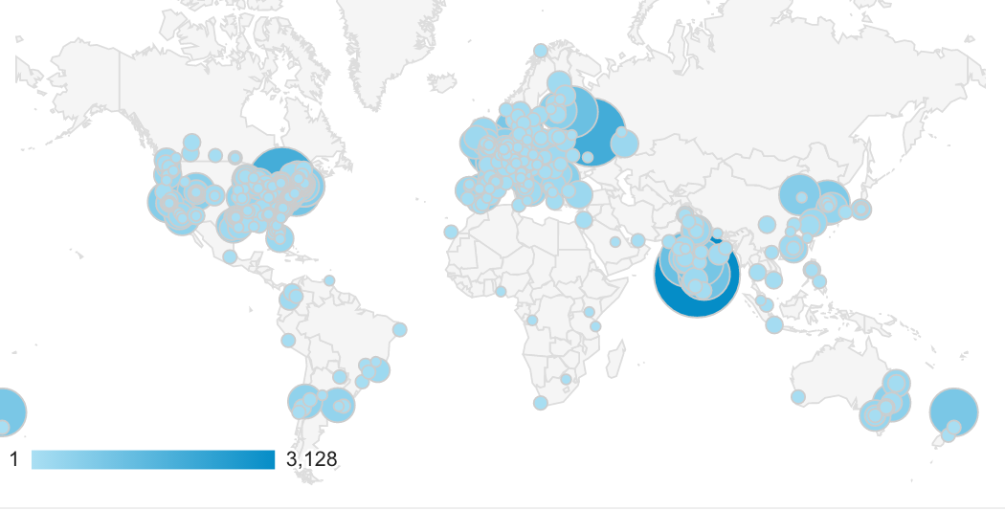
Who’s using FHIR?
Systems accessing HAPI server in previous year (as of 2017-05)
Notes:
Jan->mid Nov. 2015 – unique systems accessing the HAPI test server

Slide 19
Terminology & FHIR

Slide 20
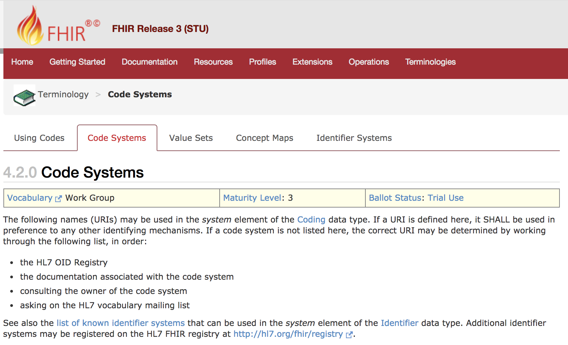
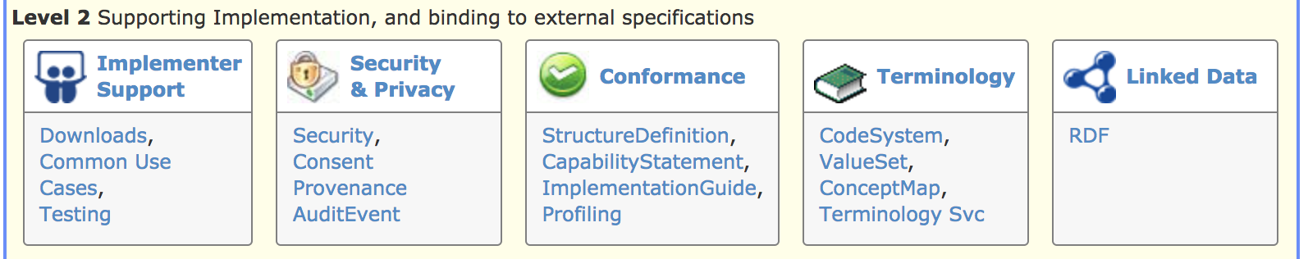


Slide 21
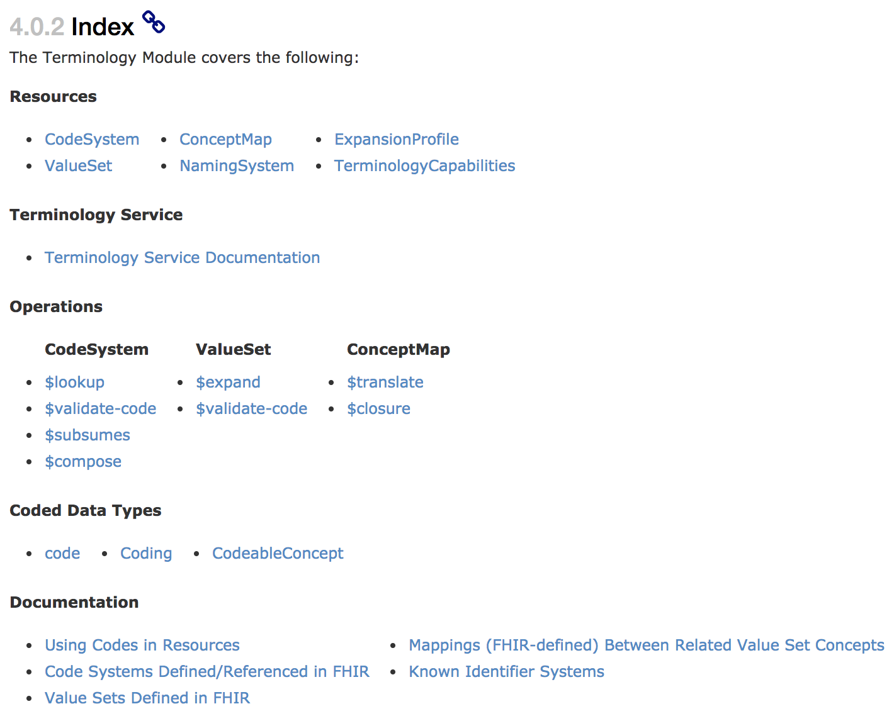
The terminology-specific resources
The terminology service and operations
The coded data types

Slide 22
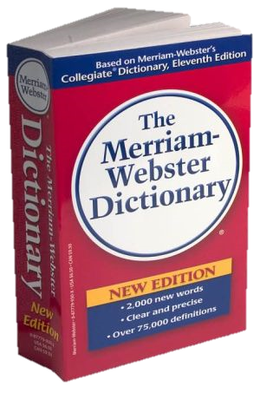
CodeSystem vs. ValueSet
“Dante’s deadly sins”
Pride
Envy
Wrath
Sloth
Avarice
Gluttony
Lust
Takes concepts from…
Definition of terms
An enumeration of terms
“CodeSystem”
“ValueSet”
Example: SNOMED-CT
Example: “Childhood diseases”

Slide 23

“Special” cases
No need to write them all down!
Takes concepts from…
“All words under B”
“All words in the
Merriam-Webster dictionary”
“Words for ‘nerd’”
Bookworm
Geek
Grind
Weenie
Wonk
Dink (slang)
Dork (slang)
Takes concepts from…
Takes concepts from…
Can take concepts from multiple codingsystems

Slide 24
Conformance levels
Fixed: You must use this value set if you send the element.
If it’s a CodeableConcept, you can sent translations too
Extensible: You must use a code from this value set if one applies
Preferred: Recommend using this code system, but ok if you don’t
Example: No recommendation, may be incomplete

Slide 25
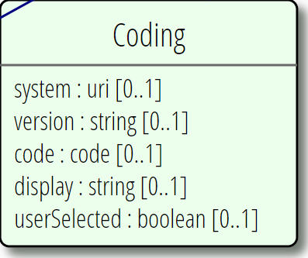
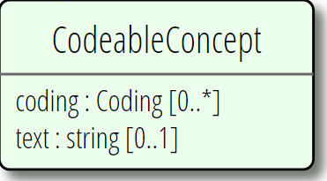
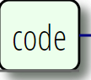
Coded Data Types

Slide 26
CodeSystem Resource
Standard mechanism for sharing metadata about code systems
For simpler code systems (i.e. not SNOMED CT ☺) can share the full codes, display names, definitions, etc.

Slide 27
ValueSet Resource
Allows sharing subsets of codes intended for a particular use
Can define
Extensional (enumerated) lists of codes
E.g. “diabetes”, “hypertension”
Intensional (expression-based) lists of code
E.g. “all SNOMED CT findings”
Can also convey their geographic/point-in-time ‘expansion’

Slide 28
ConceptMap Resource
Allows converting codes from one terminology to another
Can map code systems or map value sets
Mappings indicate “quality”
broader than, narrower than, etc.

Slide 29
Terminology artifacts as resources
Each artifact has a canonical URL
and possibly business version
Manipulatable like any clinical resource
Shared via registries
Included in documents, messages
Pointed to by profiles, protocols
Can be searched, updated, patched
Monitored via subscriptions
Parsed and manipulated using reference implementations

Slide 30
Terminology-Based Search
You can use terminology to search on:
code This code, any system system|code This code, this system |code This code, no system specified system| This system, any code
Modifiers
:text – contains match on display or CodeableConcept.text
:not – elements that don’t match the specified code
:in=valueset, :not-in
:above, :below – subsumption tests

Slide 31
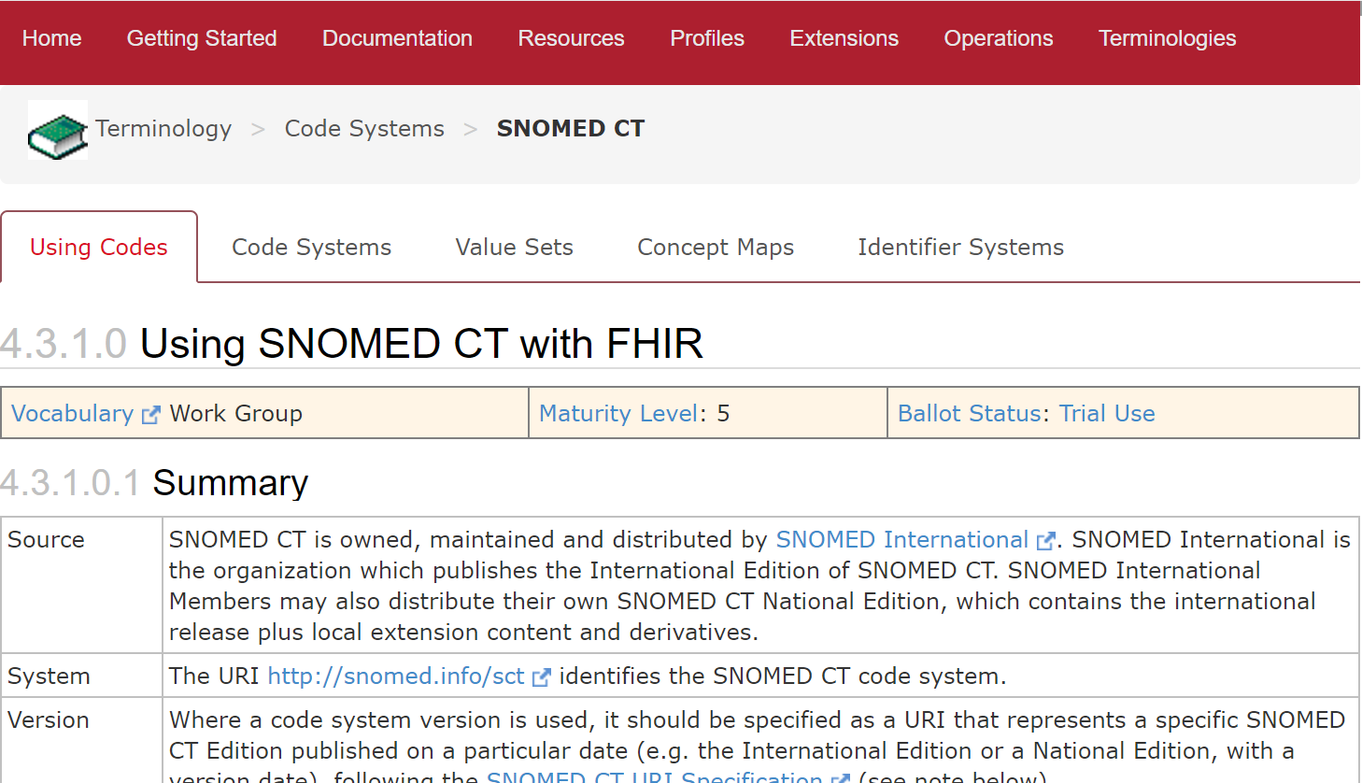
Using SNOMED CT with FHIR

Slide 32
Need for Terminology Services
Modern healthcare terminologies are complex
Doing terminology “well” requires expertise
Manipulating terminologies in code efficiently isn’t easy either
Current result
Most clinical systems barely scratch the surface of their terminologies capabilities
Terminology Services
Outsource the complexity to a system that does terminology “well”

Slide 33
Some Application Needs
Give me a list of codes
e.g., to populate my dropdown list
Is this code valid?
e.g., is the code that I received from an outside source a member of the required value set?
How do I display a code?
e.g., I need to show the preferred display term for my application context

Slide 34
More Application Needs
Translate this code to a different code system
e.g., I coded the diagnosis in SNOMED CT and now I need to submit the claim in ICD-10
Integrate terminology search into my application
e.g., my type-ahead search to enter data into the allergy list needs the value set expansion for the list of codes that should be included
How do I manage all of the changes and versions?!

Slide 35
Terminology Operations - Overview
ValueSet
$expand
$validate-code
CodeSystem
$lookup
$subsumes
$compose
$validate-code
ConceptMap
$translate
$closure

Slide 36
Questions?
Connect with the FHIR community: FHIR Zulip chat terminology stream
https://chat.fhir.org/#narrow/stream/terminology

